Slide 1
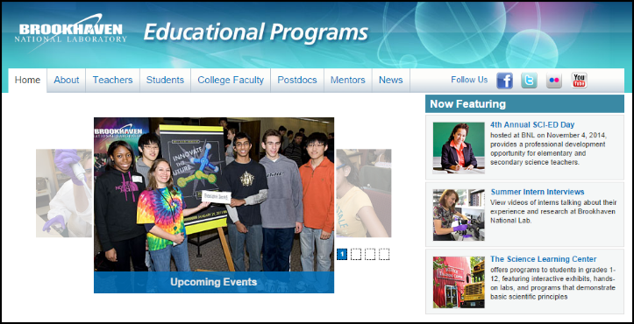
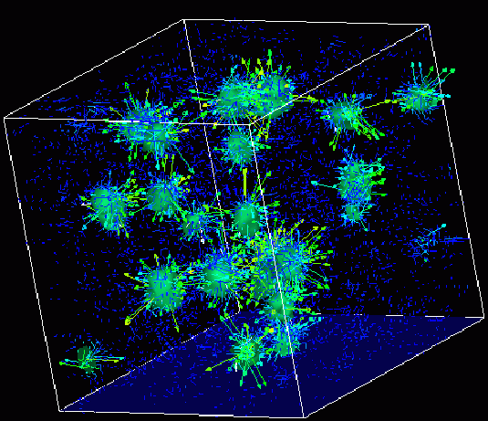
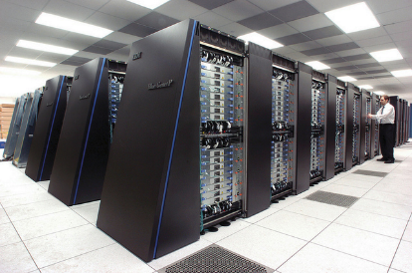
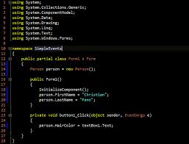
Survey of
Scientific Computing
(SciComp 301)
Dave Biersach
Brookhaven National Laboratory
dbiersach@bnl.gov
Session 08
Algorithms,
Series Convergence

Slide 2
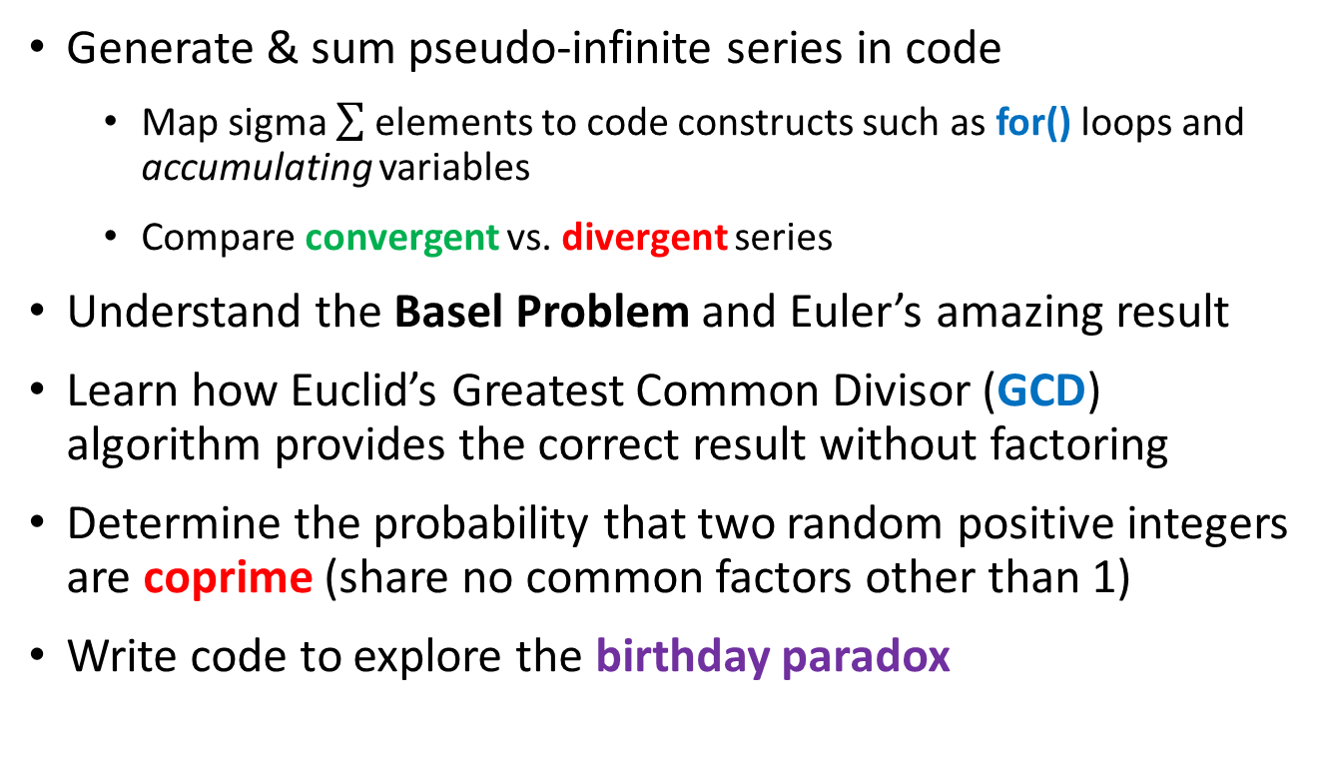
Session Goals
Generate & sum pseudo-infinite series in code
Map sigma elements to code constructs such as for() loops and accumulating variables
Compare convergent vs. divergent series
Understand the Basel Problem and Euler’s amazing result
Learn how Euclid’s Greatest Common Divisor (GCD) algorithm provides the correct result without factoring
Determine the probability that two random positive integers are coprime (share no common factors other than 1)
Write code to explore the birthday paradox

Slide 3
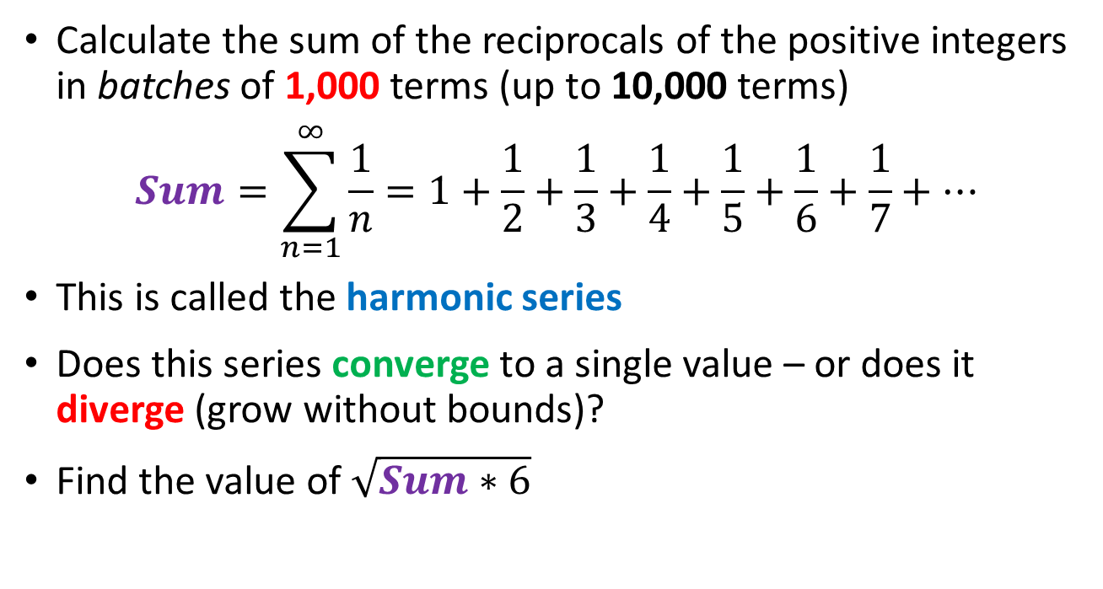
The Basel Problem
Calculate the sum of the reciprocals of the positive integers in batches of 1,000 terms (up to 10,000 terms)
$$Sum=\sum_{n=1}^{∞}{\frac{1}{n}=1+\frac{1}{2}+\frac{1}{3}+\frac{1}{4}+\frac{1}{5}+\frac{1}{6}+\frac{1}{7}+…}$$
This is called the harmonic series
Does this series converge to a single value – or does it diverge (grow without bounds)?
Find the value of $\sqrt{Sum∗6}$

Slide 4
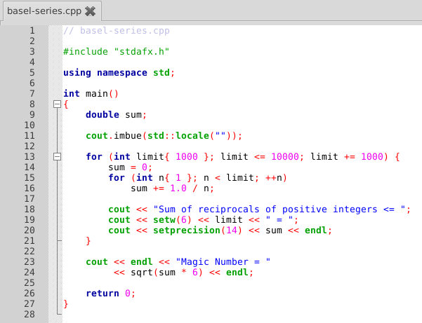
Open Lab 1 – Basel Problem
main()
cout.imbue()
Using {} to init vars
Prefix ++ op
Explicit 1.0
setw()
setprecision()
sqrt()

Slide 5
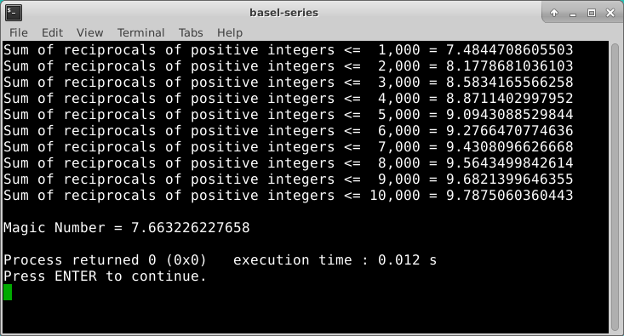
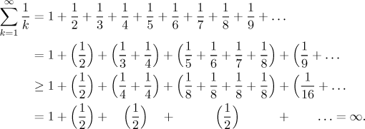
Run Lab 1 – Basel Problem
The harmonic series diverges

Slide 6
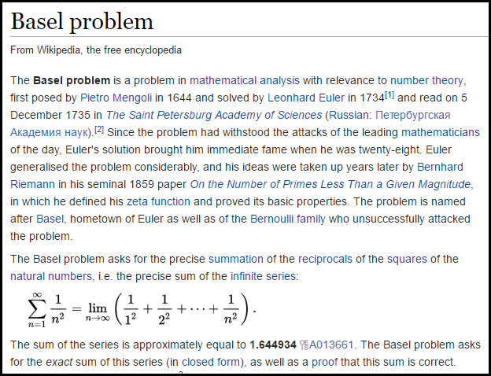

Slide 7
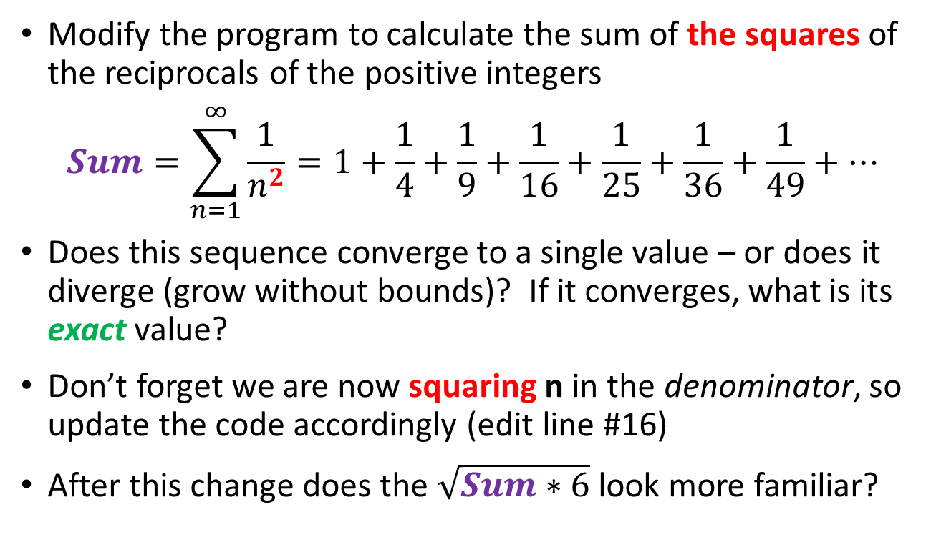
Edit Lab 1 – Basel Problem
Modify the program to calculate the sum of the squares of the reciprocals of the positive integers
$$Sum=\sum_{n=1}^{∞}{\frac{1}{n^{2}}=1+\frac{1}{4}+\frac{1}{9}+\frac{1}{16}+\frac{1}{25}+\frac{1}{36}+\frac{1}{49}+…}$$
Does this sequence converge to a single value – or does it diverge (grow without bounds)? If it converges, what is its exact value?
Don’t forget we are now squaring n in the denominator, so update the code accordingly (edit line #16)
After this change does the $\sqrt{Sum∗6}$ look more familiar?

Slide 8
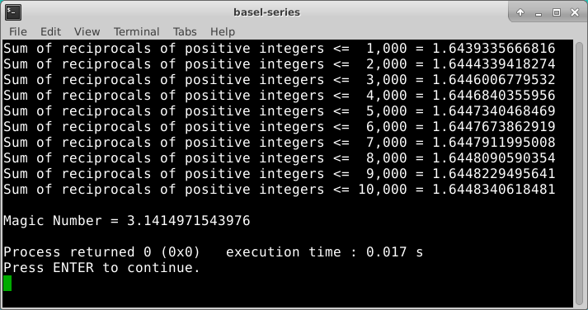
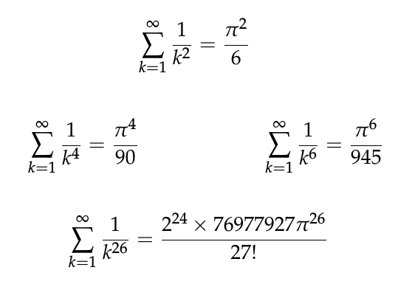
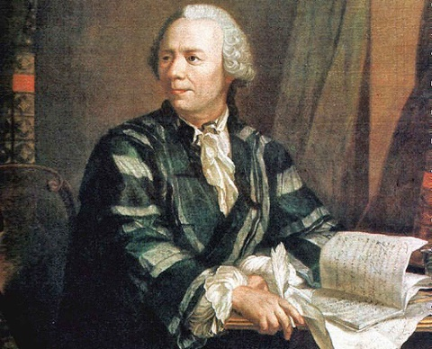
Run Lab 1 – Basel Problem
The series converges

Slide 9
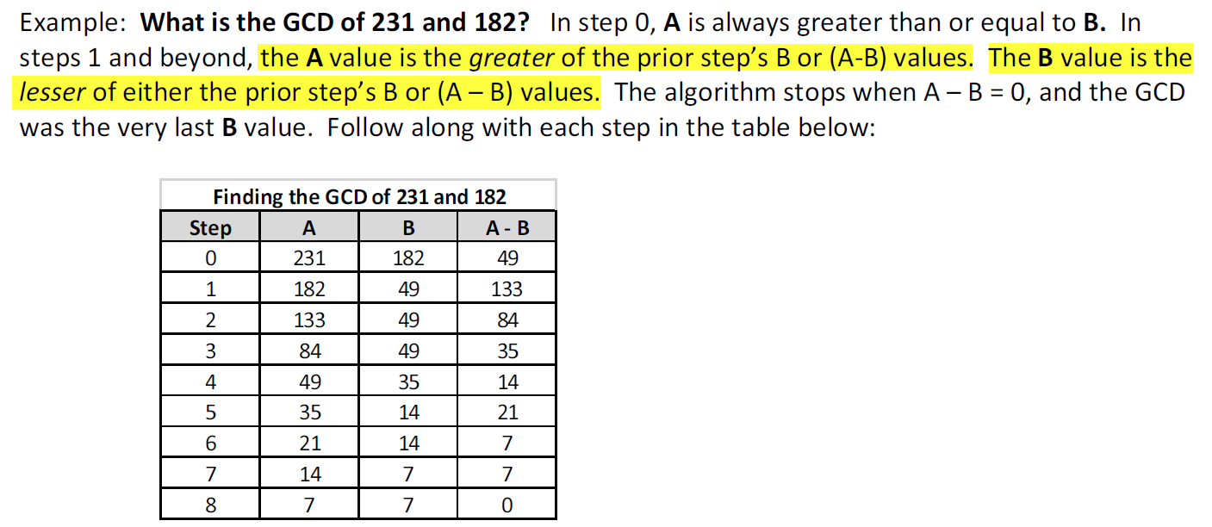
Greatest Common Divisor (GCD)
What divides A and B must also divide the difference of A - B
Why?
Given {A, B, a, b, r} ∊ ℤ
$$A=a ∗r, B=b ∗r$$
$$\left(A −B\right)=a∗r −b ∗r$$
$$a −b= \frac{\left(A −B\right)}{r}$$
∴ One can determine the GCD without having to factor either of the two integers!

Slide 10
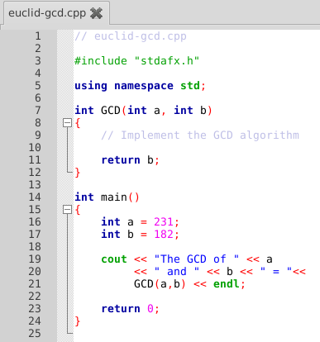
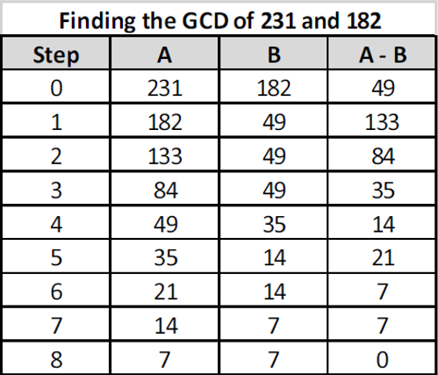

Open Lab 2 – Euclid’s GCD
Ensure $a≥b$

Slide 11
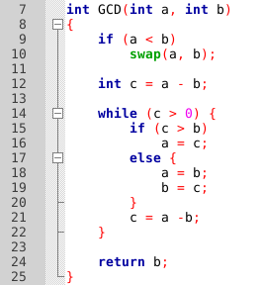
Edit Lab 2 – Euclid’s GCD

Slide 12
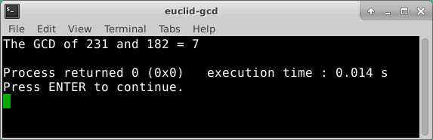
Run Lab 2 – Euclid’s GCD

Slide 13
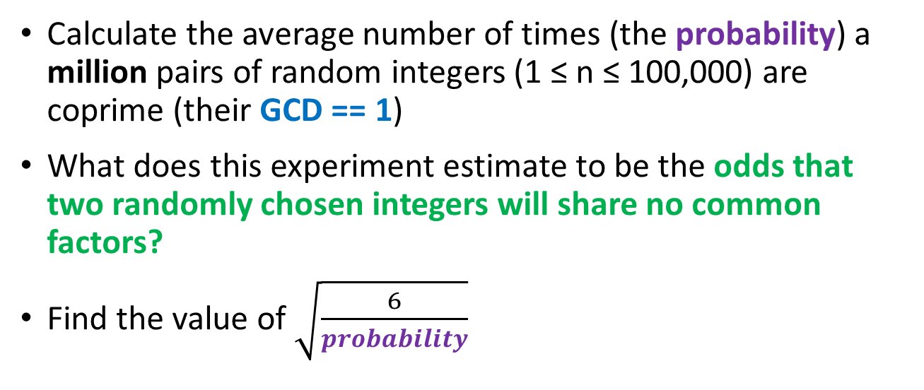
Coprime Probability
Calculate the average number of times (the probability) a million pairs of random integers (1 ≤ n ≤ 100,000) are coprime (their GCD == 1)
What does this experiment estimate to be the odds that two randomly chosen integers will share no common factors?
Find the value of $\sqrt{\frac{6}{probability}}$

Slide 14
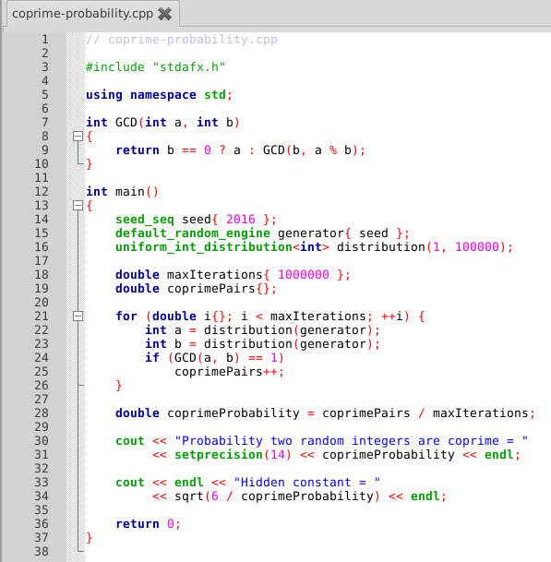
Open Lab 3 – Coprime Probability

Slide 15
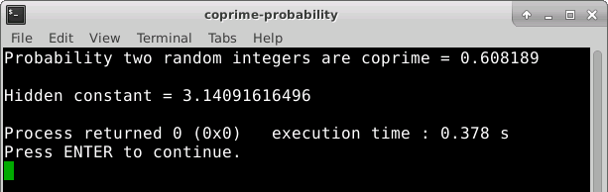


Run Lab 3 – Coprime Probability

Slide 16
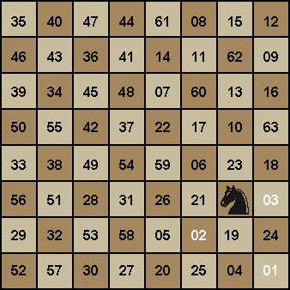
Euler’s Knight Tour

Slide 17
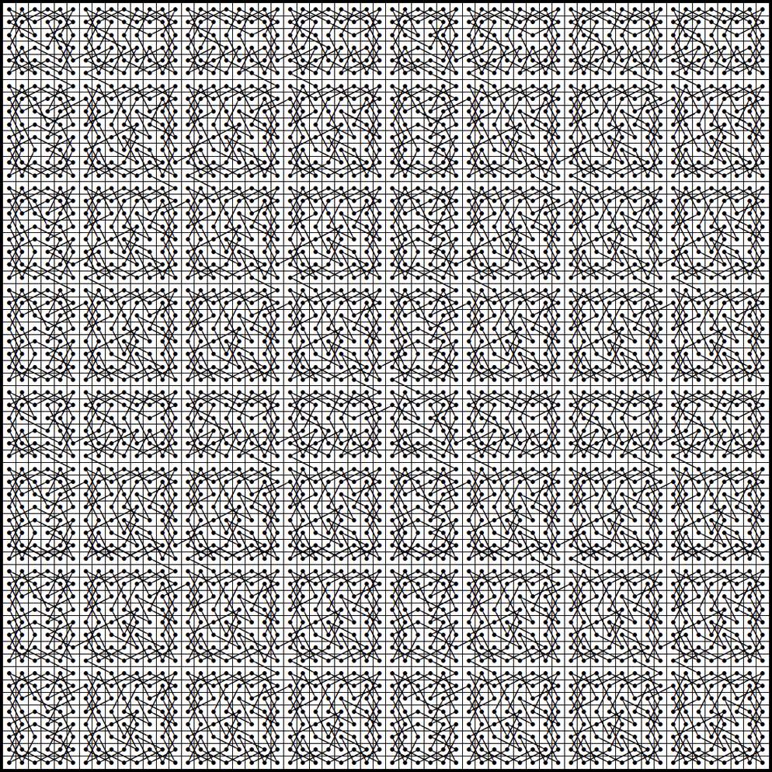

Slide 18
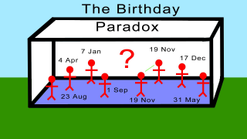
Birthday Paradox
Given a class size of n students, write a program to calculate the probability that at least two students in that class share the same birthday
Your code should calculate this probability for 10,000 classes, each between 2 and 80 students inclusive
Assume there is only 365 days in a year (no leap years)
What is the minimum required class size to have > 50% probability of two similar birthdays?

Slide 19
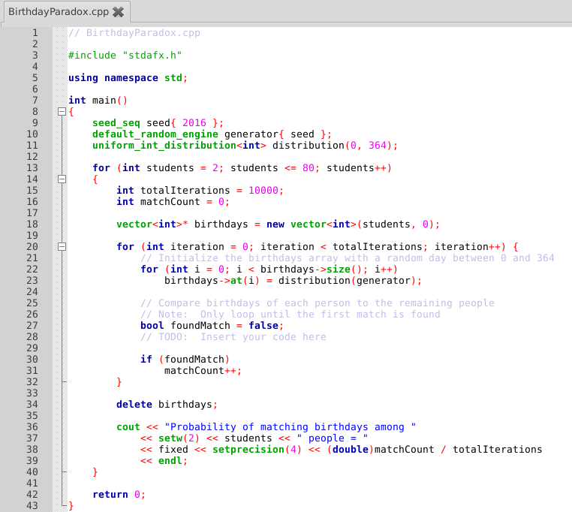
Open Lab 4 Birthday Paradox
Add the code here to find if any two students have the same birthday

Slide 20
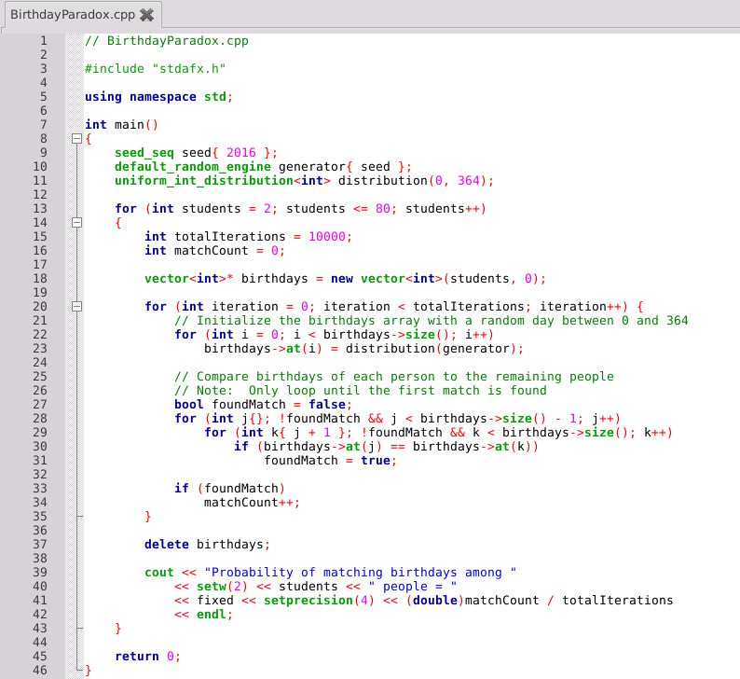
Edit Lab 4 Birthday Paradox

Slide 21
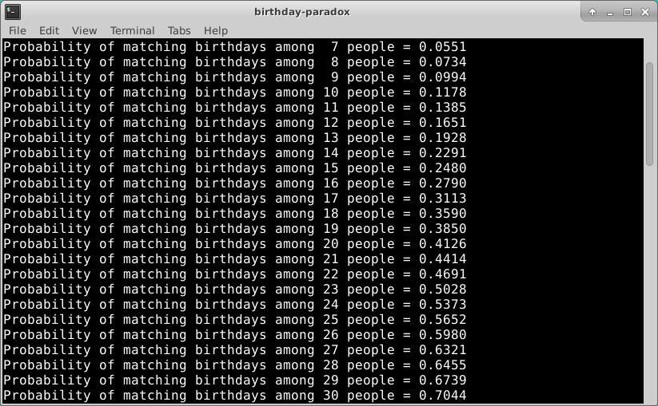
Run Lab 4 – Birthday Paradox

Slide 22
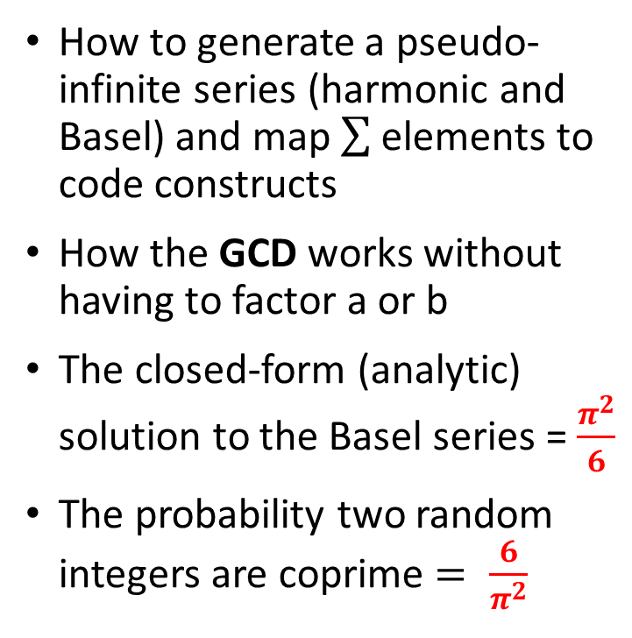
Now you know…
How to generate a pseudo-infinite series (harmonic and Basel) and map elements to code constructs
How the GCD works without having to factor a or b
The closed-form (analytic) solution to the Basel series = $\frac{π^{2}}{6}$
The probability two random integers are coprime $= \frac{6}{π^{2}}$
Some statistics are only meaningful after generating a very large sample set – everything in scientific computing is big
In a room of 80 people, there is ~100% chance that two people will share the same birthday!
Euler was smart! ☺

